Slide 1
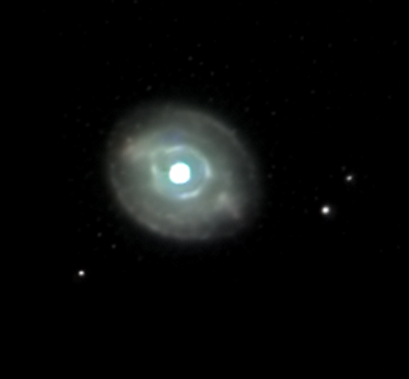
Blinking Planetary Nebula
a planetary nebula in Cygnus

Slide 2
Blinking Planetary Nebula
WHY IS IT BLINKING?
When viewed through a small telescope, the brightness of the central star overwhelms the eye when viewed directly, obscuring the surrounding nebula. However, it can be viewed well using averted vision, which causes it to "blink" in and out of view as the observer's eye wanders.

Slide 3
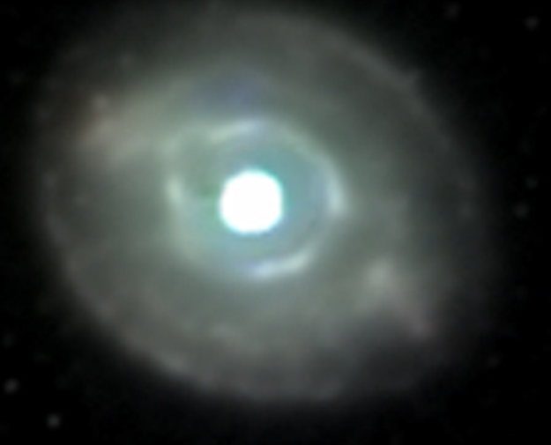
Blinking Planetary Nebula
It is one of the most prominent blinkers, but not the only one. It’s central star is among the brightest found at the center of nebulas.

Slide 4
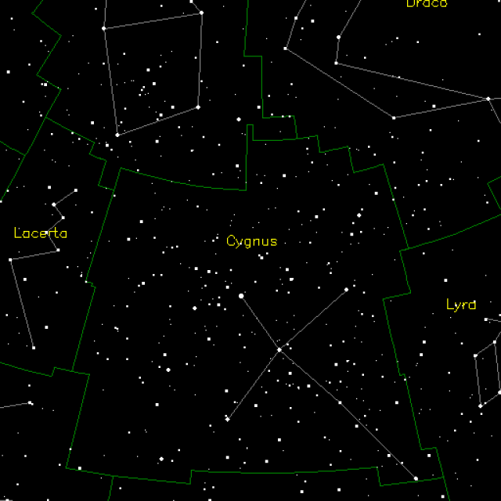
Blinking Planetary Nebula

Slide 5
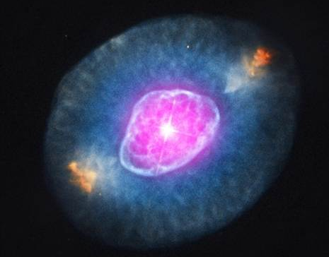
Blinking Planetary Nebula

Slide 6
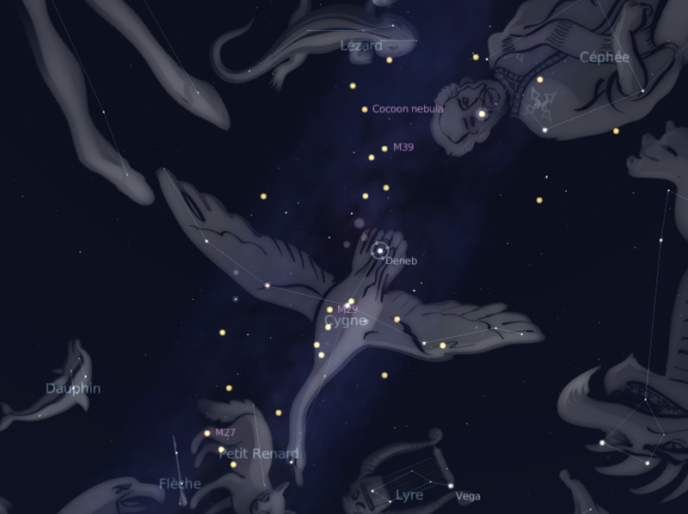
Cygnus Constellation:
The Swan
Blinking Planetary Nebula

Slide 7
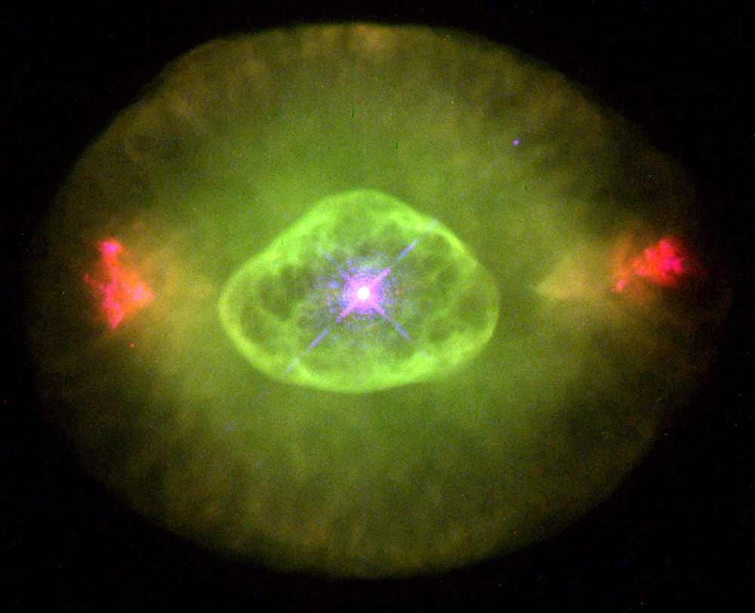
Blinking Planetary Nebula

Slide 8
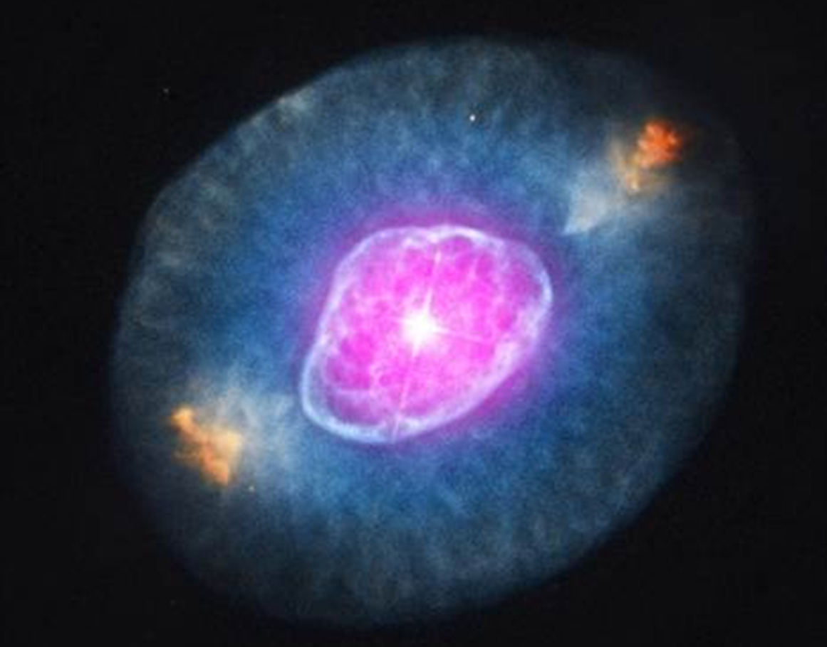
Blinking Planetary Nebula
Visual Magnitude: +8.89 (not visible to naked eye but can be seen in small telescopes)
Apparent Size: 2.1 arcminutes

Slide 9
Blinking Planetary Nebula
Distance: 2,200 light years away
Diameter: 2.6 light years across

Slide 10
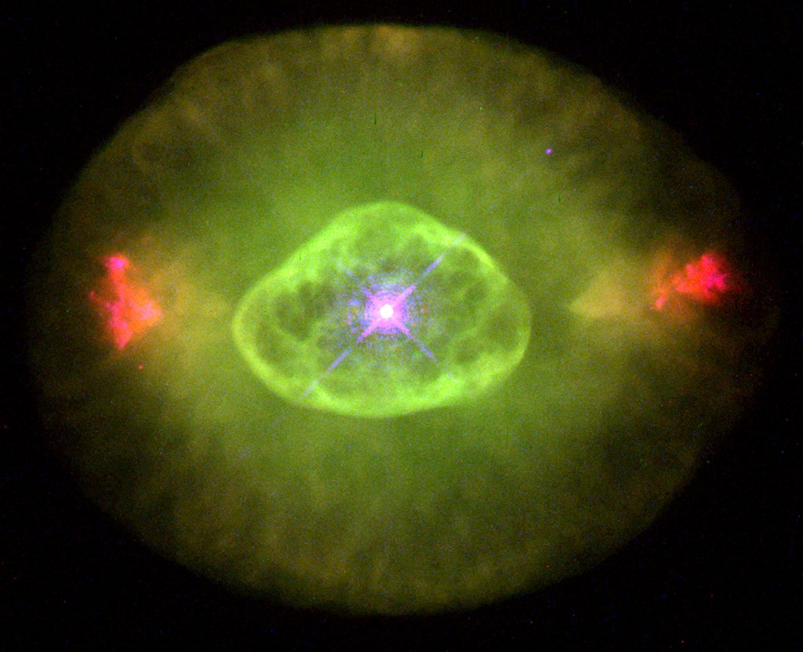
A distinctive feature of this nebula are the two bright patches on either side, which are known as Fast Low-Ionization Emission Regions, or FLIERS. They appear to be relatively young, moving outwards at supersonic speeds.

Slide 11
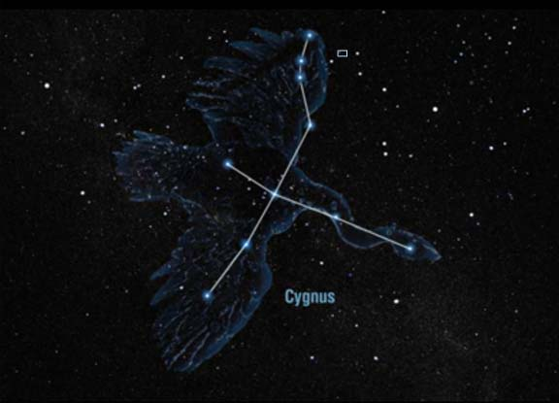
Blinking Planetary Nebula

Slide 12


Planetary Nebula Basics

Slide 13
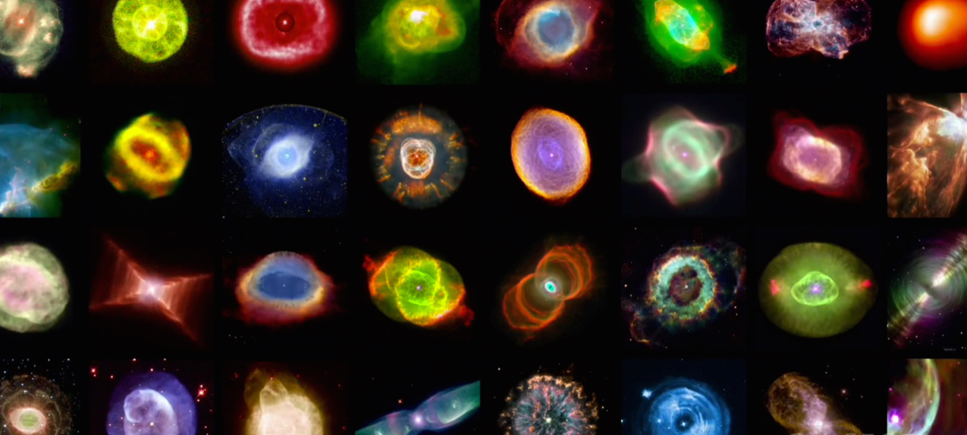
Planetary Nebula Basics
Planetary Nebula are the remains of a sun-like star that has used all of its hydrogen gas (fuel).

Slide 14
Planetary Nebula Basics
The Sun will become an object like this in 5 to 6 billion years.

Slide 15
Planetary Nebula Basics
The glowing gases were once thought to be planets in the process of forming, hence the name “planetary nebula”.

